Slide 1
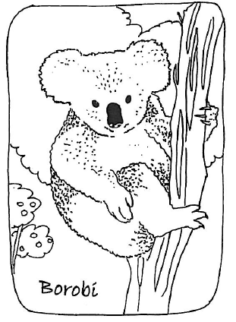
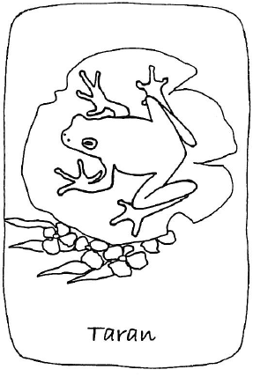
Aussie Animal Scavenger Hunt
Learning Indigenous languages through play

Slide 2
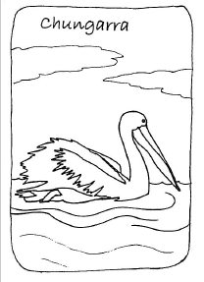
Our Idea
Use open data to create animal scavenger hunts for kids
Get children using local First Languages to name Australian animals

Slide 3
Did you know?
Late 18th century: 350 - 750 Australian social groupings and languages
Now: fewer than 150 First Languages remain spoken in daily use
Most remaining indigenous languages are highly endangered
Organisations such as First Languages Australia and Our Languages are working to preserve and restore these treasures of international significance
http://www.firstlanguages.org.au

Slide 4
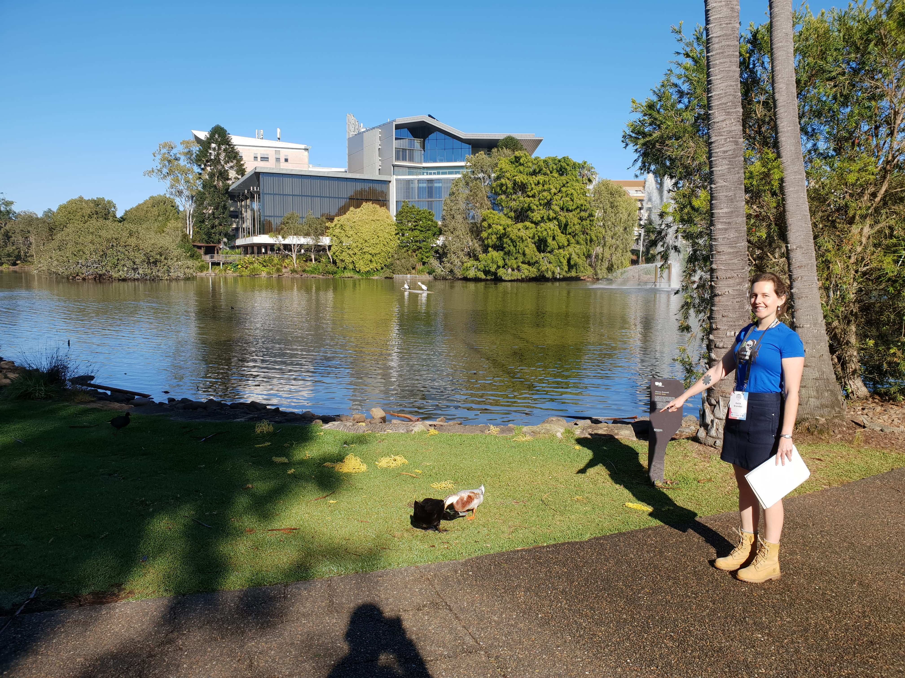
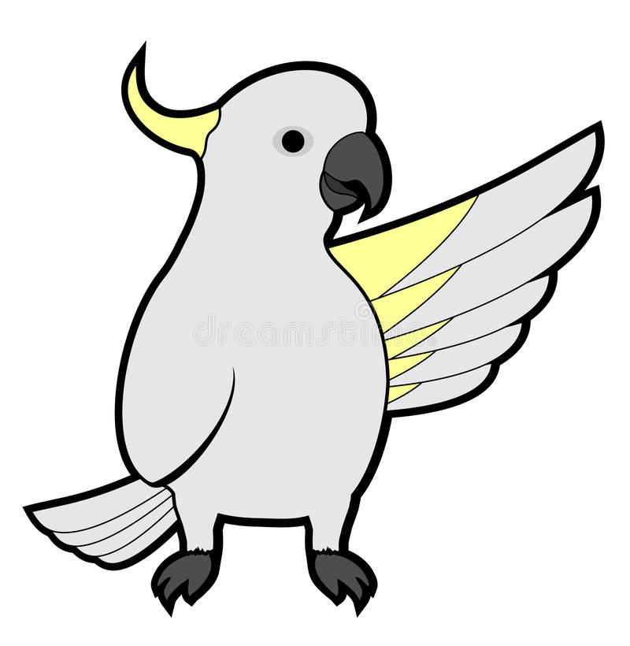
Our Goal
Raise awareness of Indigenous languages
Look, I spotted a Geira!
Engage children in learning local Indigenous animal names
Encourage kids to get outdoors and get active

Slide 5
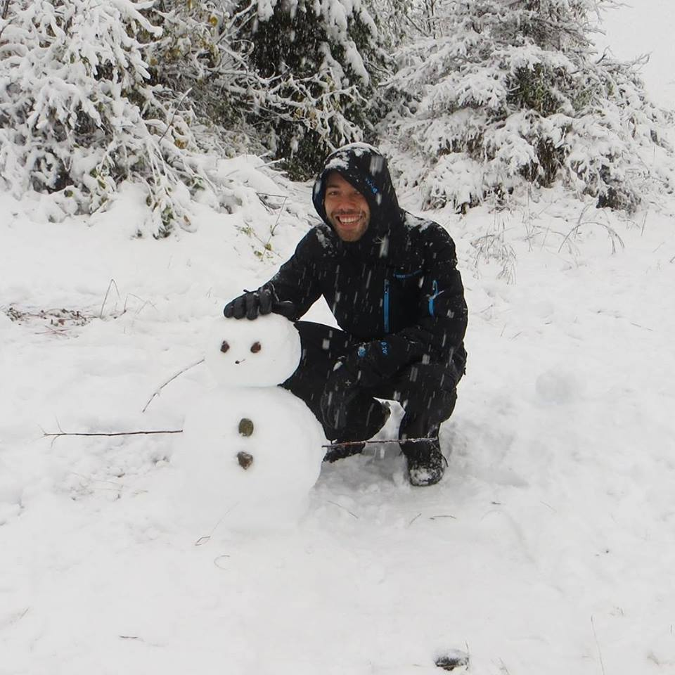
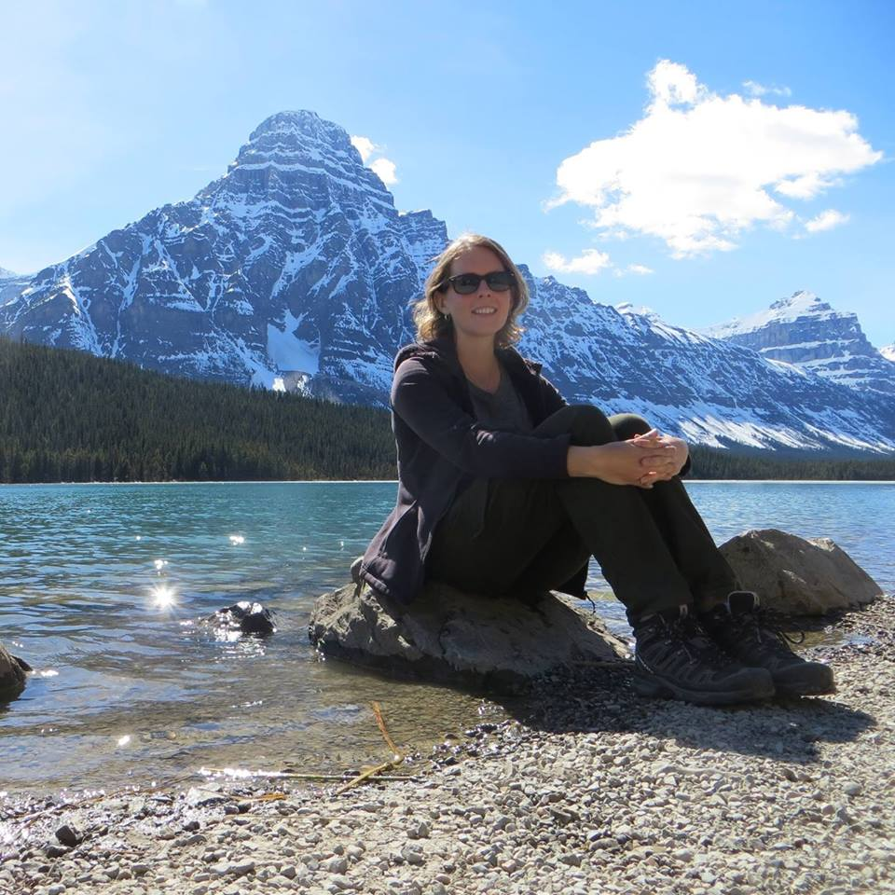
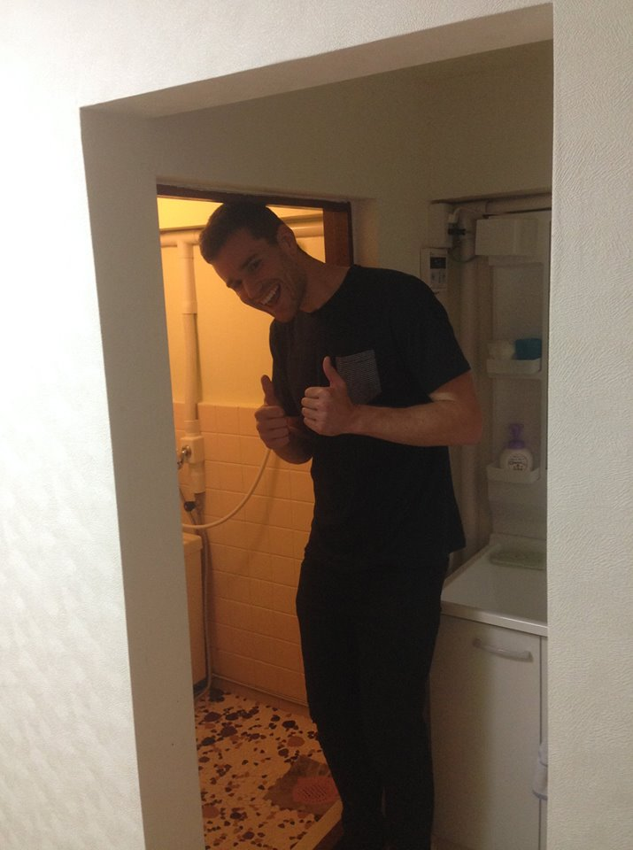

The Team
MATT
- Dev
KATIE
- Data
NICK
- Dev
GLEN
- Dev

Slide 6
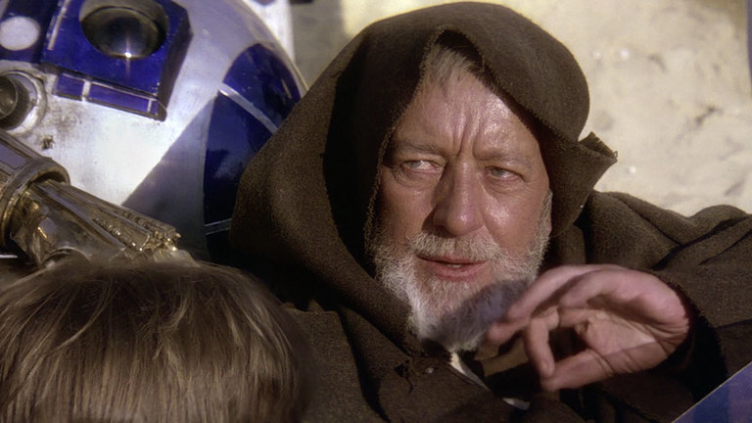
Our web design is amazing

Slide 7
The Team Name
Fellowship
Rocketship
Milksteak
Convoke

Slide 8
Our team name is also amazing

Slide 9
Aussie Animal Scavenger Hunt : How it works
Scavenger Hunt Guides use our website to:
Navigate the map to their local area
Print out maps for scavenger hunt
In the field
Guides lead the animal scavenger hunt using map and language dictionary
Kids fill out animal checklist with local Indigenous words
Tick off checklist as they explore the area

Slide 10
Aussie Animal Scavenger Hunt: An educational toolkit
Scavenger Hunt Guides could be teachers, parents or caregivers working alongside or within Aboriginal and Torres Strait Islander families, groups and communities
Scavenger Hunt Maps are paper based to promote inclusivity across regional communities

Slide 11
The Prototype – Gold Coast Region, Yugambeh Language
Open data used
Fauna surveys (Gold Coast City Council)
Walking trails (Gold Coast City Council)
QTopo Basemap (QLD Government)
Modern Yugambeh Language Dictionary (Yugambeh Museum)

Slide 12
The Software Stack
Simple single page HTML5 application consuming web services.
Data requiring enrichment is transformed into a fit for purpose data store using Feature Manipulation Engine software.
The JavaScript libraries behind the scenes are Leaflet for the mapping and JQuery for the DOM manipulation.

Slide 13
Website Demo!

Slide 14
Printout Map Demo!

Slide 15
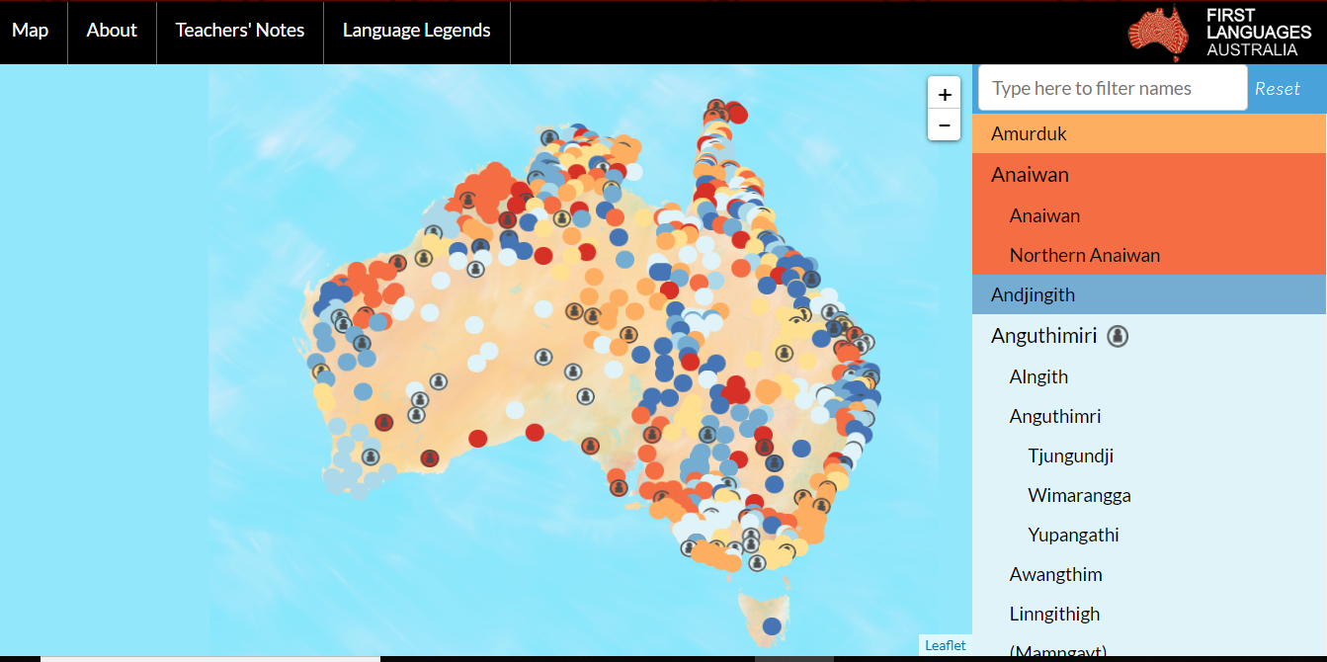
Aussie Animal Scavenger Hunt: Challenges
Pronunciations
Gambay Map can be used to hear spoken languages

Slide 16
Aussie Animal Scavenger Hunt: Looking Ahead
Complete our working prototype to share as a proof of concept
Consult with Yugambeh People and Yugambeh Museum to create sound recordings of animal names
Work with Indigenous Language Centres and organisations to discuss possibility of expanding product to include more languages
Work with Local Governments to discuss the possibility of crowd sourcing fauna survey data
Explore idea of sharing fauna survey map as a tourist hiking guide

Slide 17
The End
Thank you for watching

Slide 18
Add a Slide Title - 2

Slide 19
Add a Slide Title - 3

